Slide 1
Taxa application – Group 3/4
https://github.com/nigellium/Taxa
Notes:
Hello, my name is Nigel Spaulding. I am in group 3/4, and my team members are: …

Slide 2
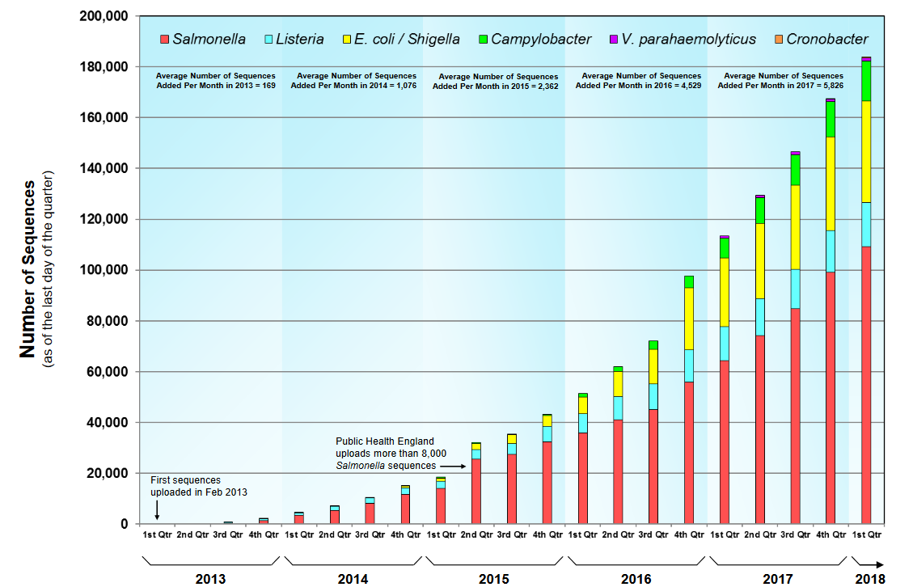
Background
https://www.ncbi.nlm.nih.gov/pathogens
https://www.fda.gov/Food/FoodScienceResearch/WholeGenomeSequencingProgramWGS/ucm403550.htm
Notes:
Thousands of genomes/month, 1 TB/month
The need to detect contamination
The need to define different species
We have a need to automate a very manual process
No tool yet exists for manipulating and querying taxonomy information

Slide 3
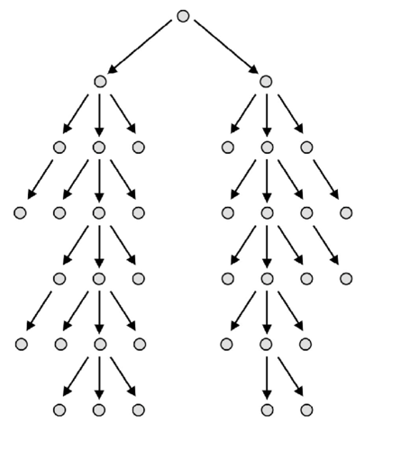
Detecting contamination in genomes
Look for conflicts
Conflicts == contamination
Need to define new species

Slide 4
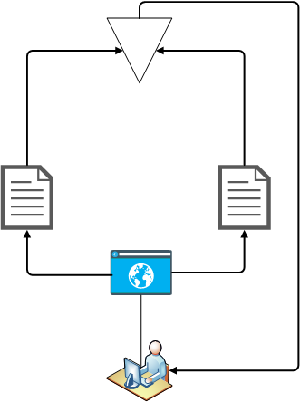
The application!
Queries and manipulates taxonomy
Microservice
Springboot
ECPass
[live demo]
Notes:
We created a interface/api/tool/etc that can manipulate and query a taxonomy database
Web interface, API
Features: quick search, create child/parent relationships, portability (web interface), cross-platform (web interface)

Slide 5

Team Three Quarters
Nigel Spaulding Developer and Presenter Lee Katz SME Julia The Meh Huynh SME The Funny half of Peter White Developer Selva Pasupathi Developer Steve Gu Developer Tony Pruitt Designer
https://github.com/nigellium/Taxa/

Slide 6
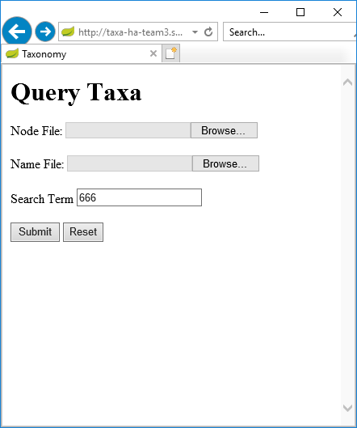
QUERY TAXA

Slide 7
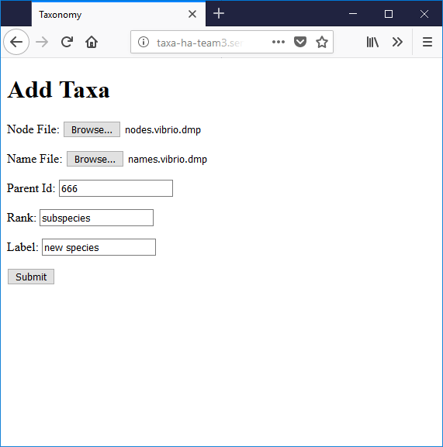
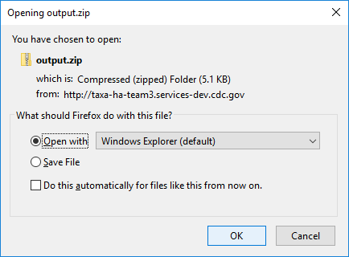
ADD TAXA

Slide 8
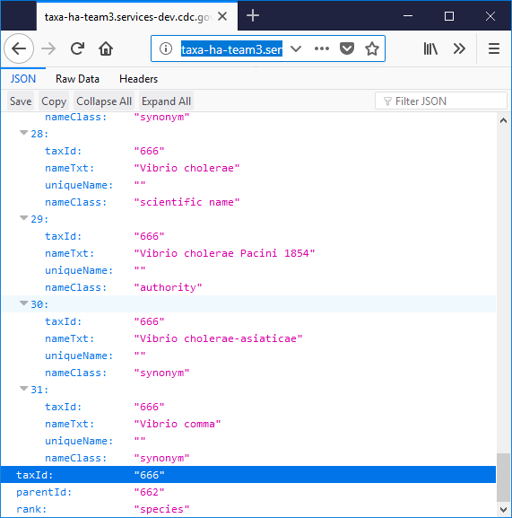
JSON return

